Slide 1
Principles of parallel and Distributed Computing

Slide 2
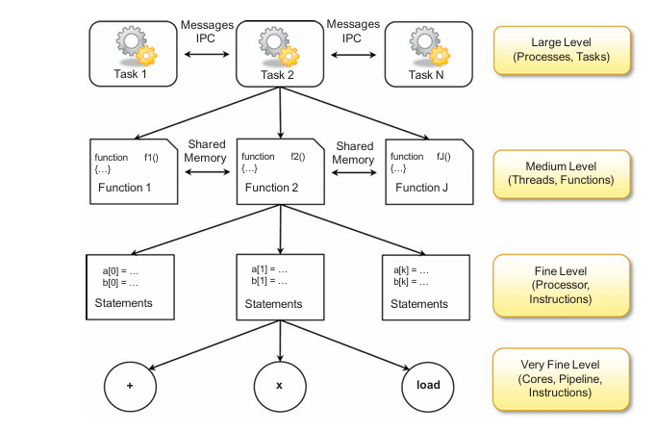
Eras of Computing: Parallelism vs Sequential Computation
What is Parallel Computing?
Elements of Parallel Processing
MIMD: Shared vs Distributed memory
Easy?
Tolerant to failure ?
Better scalable?
Code grains for processor efficiency

Slide 3
Elements of Distributed Computing
A distributed system is a collection of independent computers that appears to its users as a single coherent system
Communication type ?
Software architect ?
Data-flow Architectures
Batch sequential : composed of sequences
Pipe filter style : express activity of a software system as data streams.
cat file name,| grep pattern, | wc
scanning j parsing j semantic analysis j code generation)
Repository architectural : Blackboard systems
Knowledge sources: update knowledge base
Blackboard: represent data structure shared with KB
Control : collection of rules, procedures
Virtual machine architectures:
Rule based Style: abstract execution environment as an interface:
Interpreter style : with an interpretation engine having internal memory with pseudo code

Slide 4
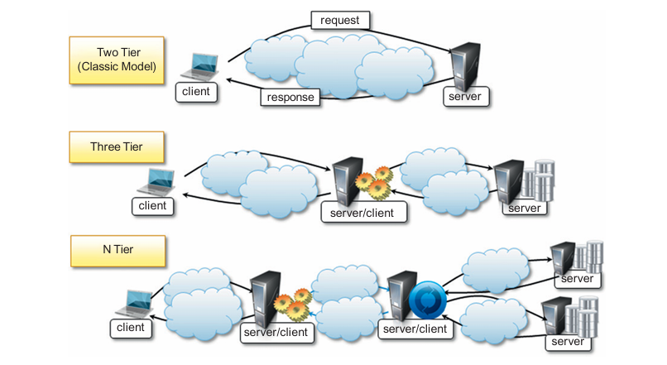
System architectures
Client/ server
Thin client model
Fat client model
Two tier architecture
Three.. N tiers architectures
Peer to peer

Slide 5
Models for IPC
Shared memory
Message Passing : Point to point, Publish and Subscribe message model,
Remote procedure call
Distributed Objects
Web Services

Slide 6
Communication technology for distributed computing
Remote Procedure call

Slide 7
Service Oriented Computing
What is Service ?
A service encapsulates a software component that provides a set of coherent and related functionalities that can be reused and integrated into bigger and more complex applications.
four major characteristics that identify a service:
• Boundaries are explicit.
Services are autonomous.
Services share schema and contracts, not class or interface definitions (XML, SOAP)
Services compatibility is determined based on policy.

